Slide 1
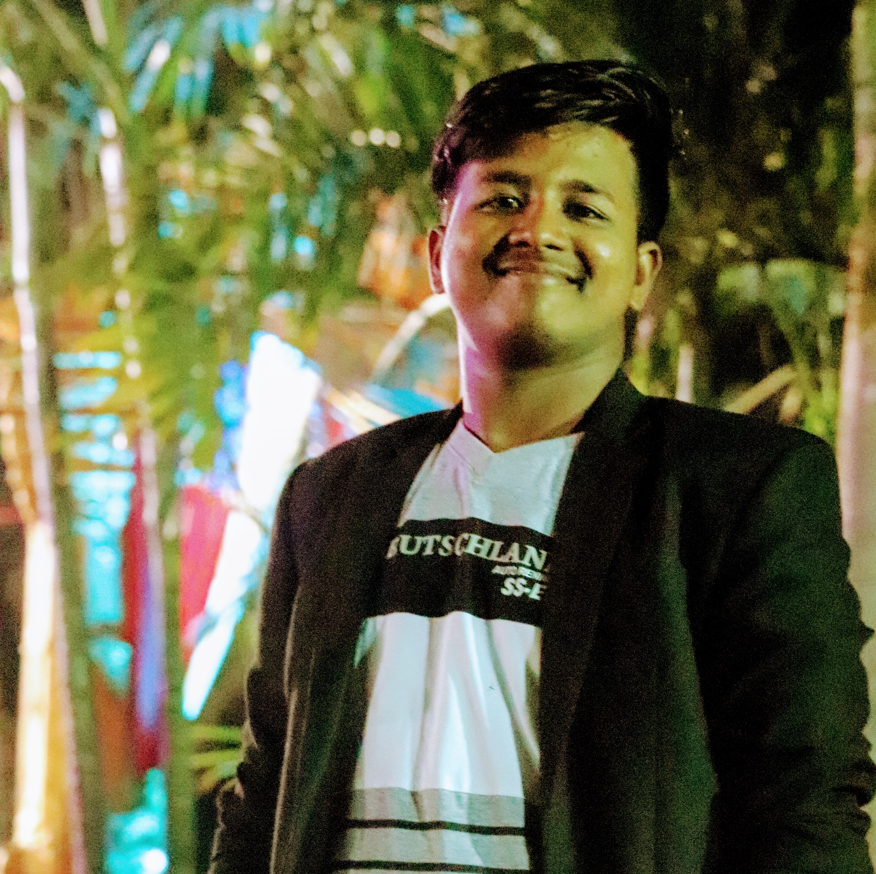


Kranthi Kumar Nethi
Analyst/Software Engineer
Education | Bachelor of Technology in Computer Science and Engineering(2017-2021)
Java 8 /J2EE | Java Basics, OOPS, Generics, Collections, Arrays, Loops, Lambda Exp, Stream API Junit, Mockito, Servlets
Spring core | IOC & Dependency Injection, Autowire
Spring REST | REST controllers, Implementation of GET, POST, PUT & DELETE, Bean Validation & Exception Handling, Testing Services, Controller & Repository layer
Spring Data JPA | Implement DAO layer using spring Data repositories, Transaction Management
Spring Boot Microservices | Spring Boot Starters, annotations, Messaging Service, Sync/Async comms, Swagger API specifications
Spring Cloud | Eureka, spring cloud API gateway,Config Server
Angular | Components, Services, Modules, Routing, Forms & Validation, Testing using Jasmin & Karma
Database | MongoDB No Sql
UI Tech | HTML 5 & CSS 3,JavaScript, ES6 & TypeScript Reusable templates, Optimized UI Designed
Tools | Git, Postman, STS IDE,AdobeXD
Add On skills | Problem Solving skills,efficiently convey my understanding through communication
Bangalore
kranthi-kumar.nethi@capgemini.com
9381138132
A4
A skilled programmer with undergraduate degree in the field of computer science and engineering with vivid perspective towards the technology.
An abstact view on designing and developing the applications and evident knowledge in Design thinking and UI/UX.
Hands on experience in creating Single page applications using Angular,spring Boot and MongoDB.
Having knowledge in creating applications using Microservices using Spring Boot,spring Cloud Api Gateway,and a demonstrated knowledge on communication between the microservices and Eureka Server. Intermediate knowledge in RabbitMQ
A clear understanding in Angular routes,Template driven forms and Reactive Forms.
Technology enthusiast, interested in discovering new things and ability to work as team player
On Demand Car Wash System
Successfully completed case study On Demand Car wash system which is a single page application.
Used Angular,Bootstap and JavaScript as a front end technologies.
Microservices architecture is implemented in this casestudy using spring Boot,spring Boot Cloud API gateway,and implemented version controlling using git Hub.
Implemented MongoDB as backend using Mongo Atlas.
Website for Photography agency
Developed a Responsive static website for a photography agency using HTML,CSS and BOOTSTRAP
Front End Web Development using Bootstrap and Jquery
Completed this course with 90% and Designed responsive Restaurant website using HTML5 CSS3 and Bootstrap
Check out my work on GitHub & Video Profile

